Slide 1
Kalos Pharma Assignment
Ravi

Slide 2
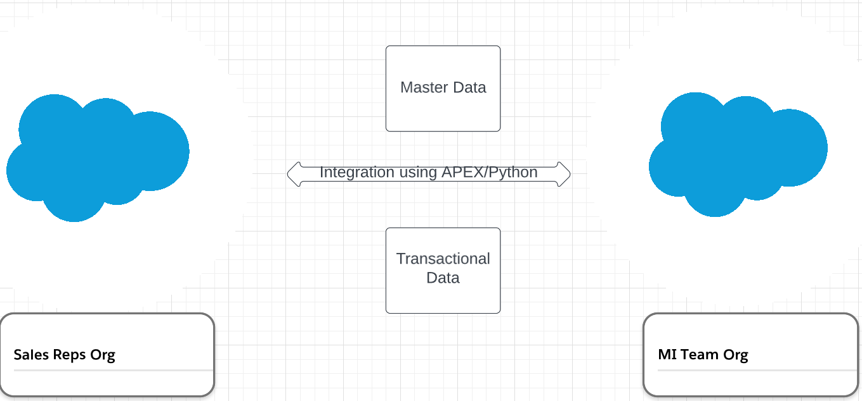
Environment

Slide 3
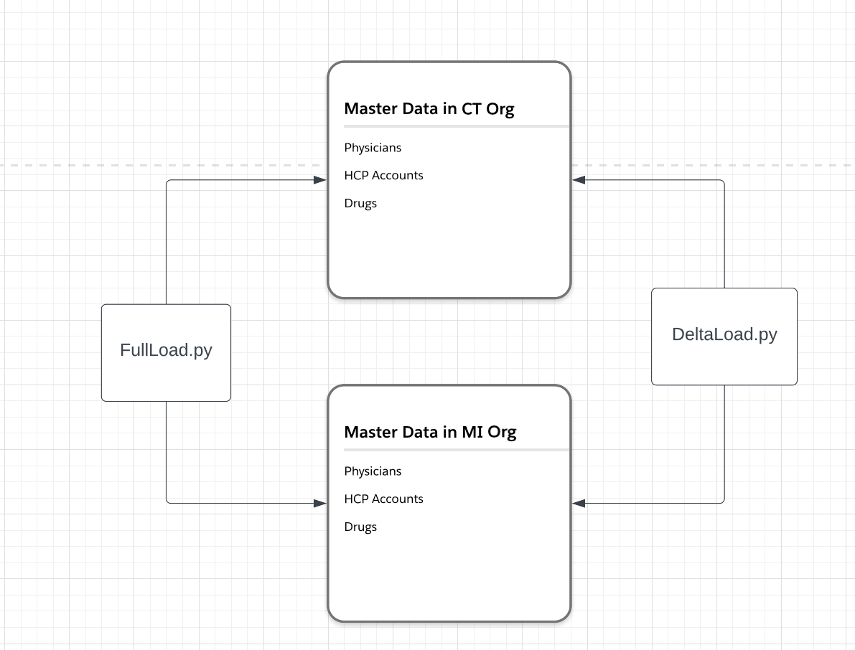
Multi Org Integration – Master Data

Slide 4
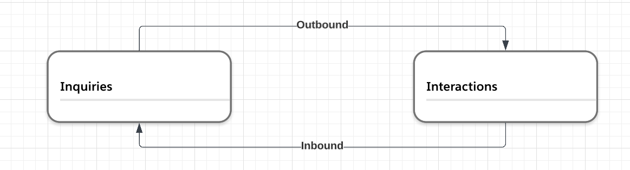
Multi Org Integration – Transactional Data

Slide 5
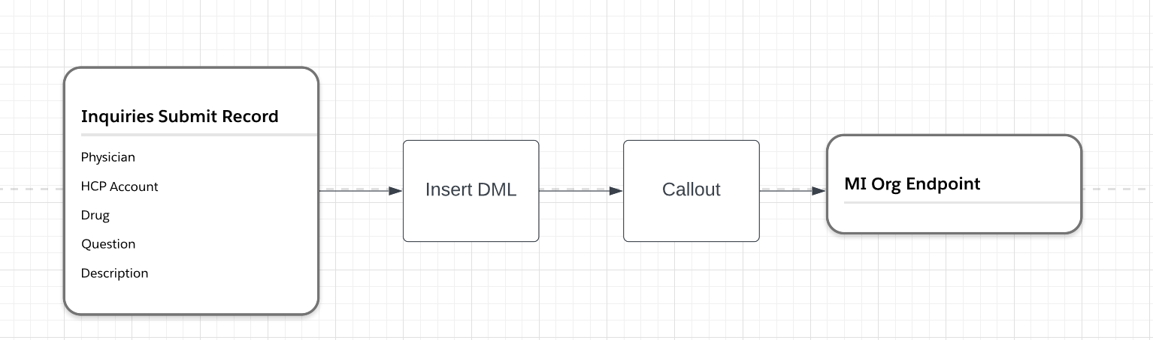
Inquiries to Interactions

Slide 6
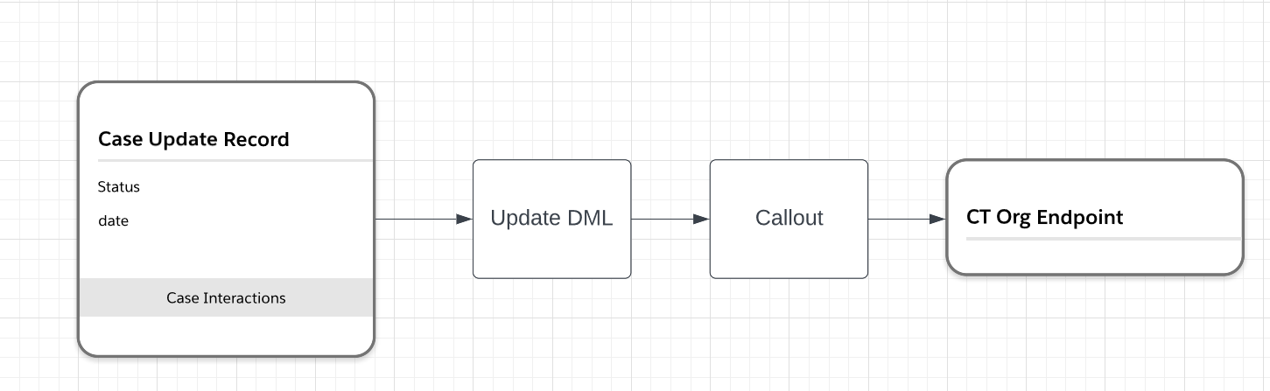
Interactions to Inquiries

Slide 7
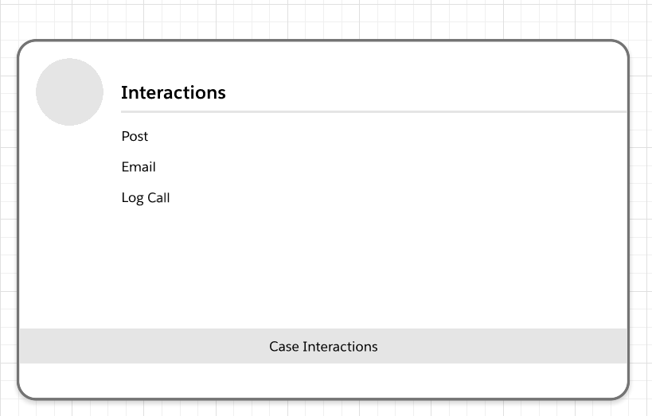
Case Interactions

Slide 8
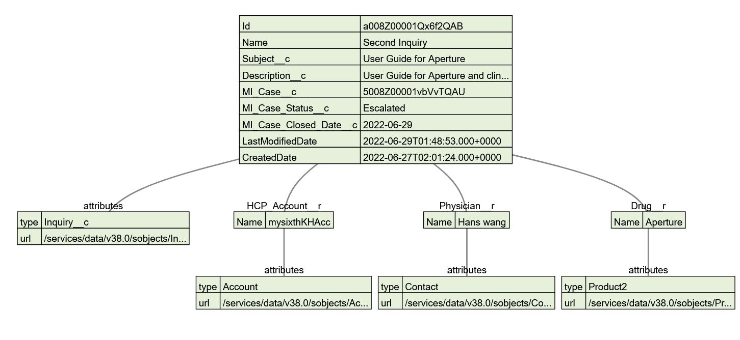
Inquiry Data Model

Slide 9
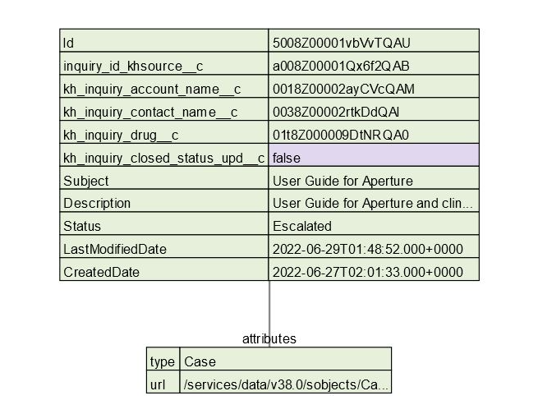
Interaction Case Data

Slide 10
Questions?

